Slide 1

Tableau Project

Slide 2
Introduction
This user story describes the requirements for creating two tableau dashboards that will assist executives and sales managers in analyzing customer and sales performance.
DashBoard Overview :
This user story describes the requirements for creating two tableau dashboards that will assist executives and sales managers in analyzing customer and sales performance.
Sales Dashboard
Customer Dashboard

Slide 3
Sales Dashboard
An overview of sales metrics and trends is provided by the sales dashboard in order to help with understanding and analyzing sales trends and year-over-year performance analysis.
In 3 points
KPIs
Product Subcategory Comparison
Weekly Trends for Sales & Profit

Slide 4
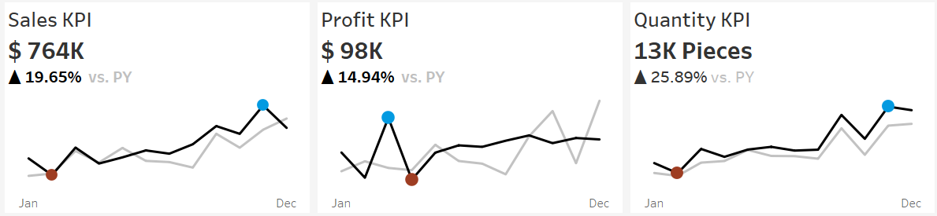
1- KPIs
a summary of total sales, profits and quantity for the current year and the previous year.

Slide 5
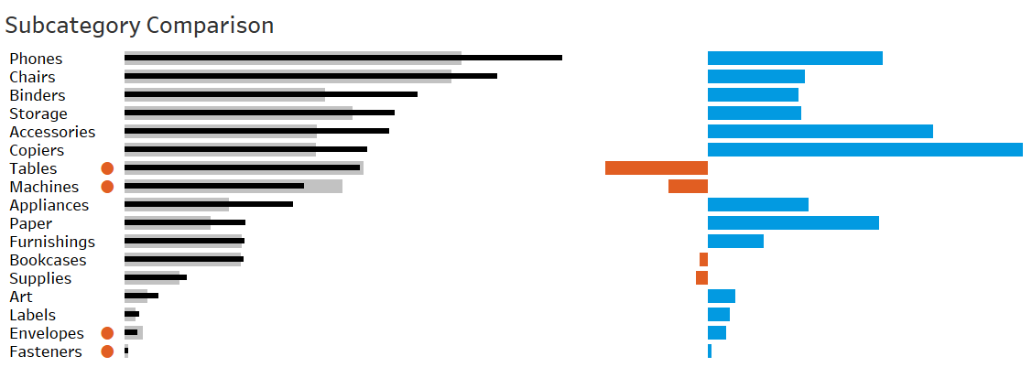
2- Product Subcategory Comparison
Analyze sales figures for the current and prior years across various product subcategories.
Provide a comparison between profit and sales.

Slide 6
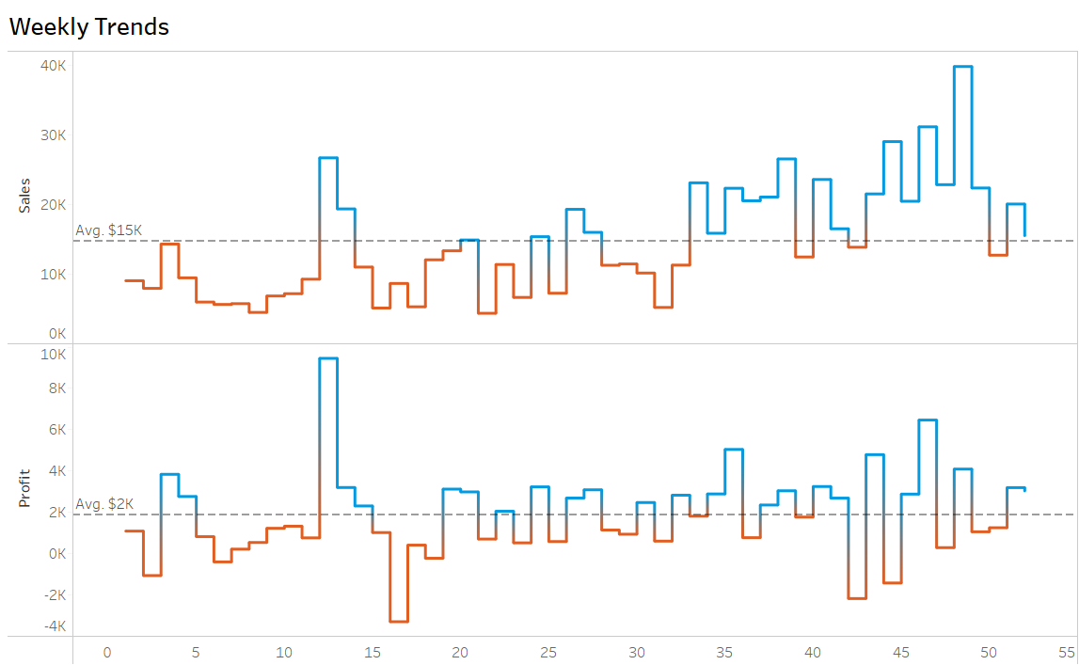
3- Weekly Trends for Sales & Profit
Present weekly sales and profit data for the current year.

Slide 7
Customer Dashboard
An overview of client data, trends, and behaviors is intended to be provided via the customer dashboard. It would assist management and marketing teams in better understanding client groups and raising customer satisfaction.
3 point also
KPIs
Customer Distribution by Number of Orders
Top 10 Customers By Profit

Slide 8
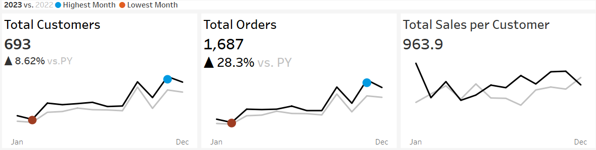
1- KPIs
a summary of total number of customers , total sales per customer and total number of orders for the current year and the previous year.

Slide 9
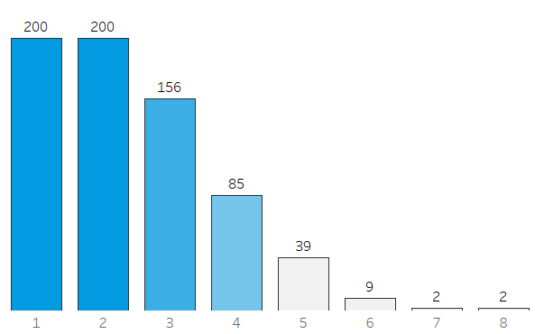
2- Customer Distribution by Num of Orders
Represent the distribution of customers based on the number of orders they have placed to provide insights into customer behavior, loyalty and engagement.

Slide 10
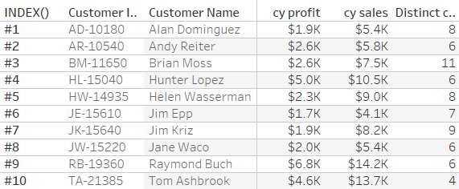
3- Top 10 Customers By Profit
Present the top 10 customers who have generated the highest profits for the company.
Show additional information like rank, number of orders, current sales, current profit

Slide 11


